Slide 1
Pls 2000 power & politics Dr. shannon
Power, Authority & The State

Slide 2
power, authority & THE STATE
I. STATE
II. POWER
III. AUTHORITY
TERMS TO KNOW
Sovereignty: Internal, External, De facto, De Jure Fragile State
Power & 3 Faces of Power Legitimacy
Influence Pluralism
Authority & 3 Types: Traditional, Charismatic, Legal-Rational Elitism
False Consciousness New Right

Slide 3
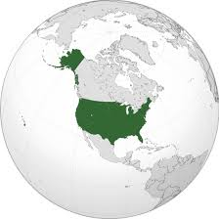
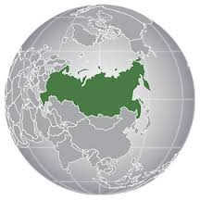
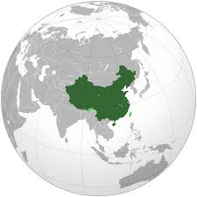
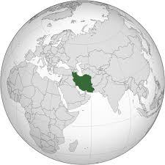
I. state
A system of institutions claiming a “monopoly of the legitimate use of physical force in enforcing its order within a given territorial area”
-Max Weber
Population
Borders
Government
Sovereignty: possessing the highest authority within a particular territory

Slide 4
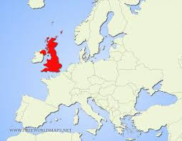
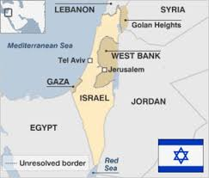
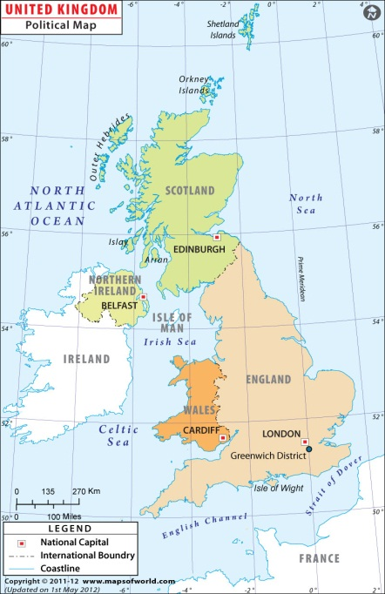
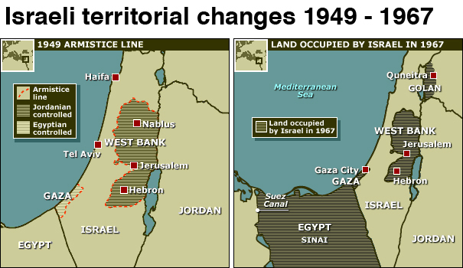
I. state
Population
Borders
Government
Sovereignty: possessing the highest authority within a particular territory
External sovereignty: granted by international community; without foreign control or interference
De jure: granted by law
Defacto: possessed by power

Slide 5
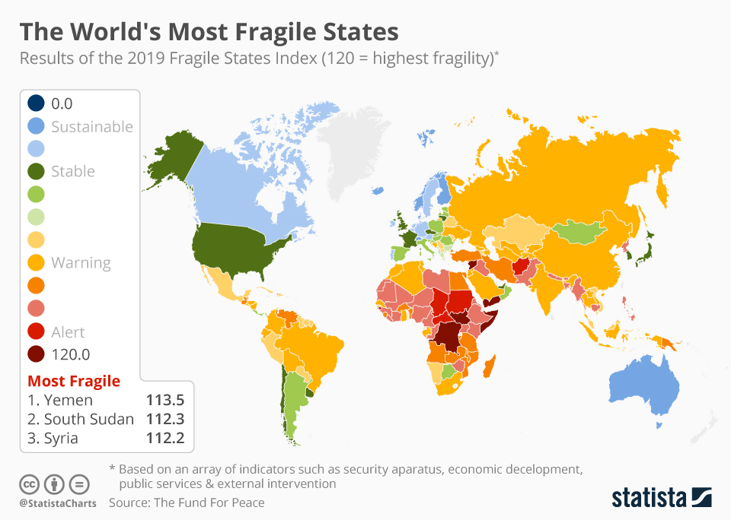
I. state
Population
Borders
Government
Sovereignty: possessing the highest authority within a particular territory
Internal sovereignty: granted by the people; without internal challengers
Fragile State: Lacking the legitimacy, capacity or will to provide political goods & functions to all (p.177)
Human security
Methods of fair adjudication of disputes
Freedom of participation in politics
https://www.statista.com/chart/19070/results-of-the-fragile-states-index/
Notes:
Examples of when a state lacked internal sovereignty : American civil war

Slide 6
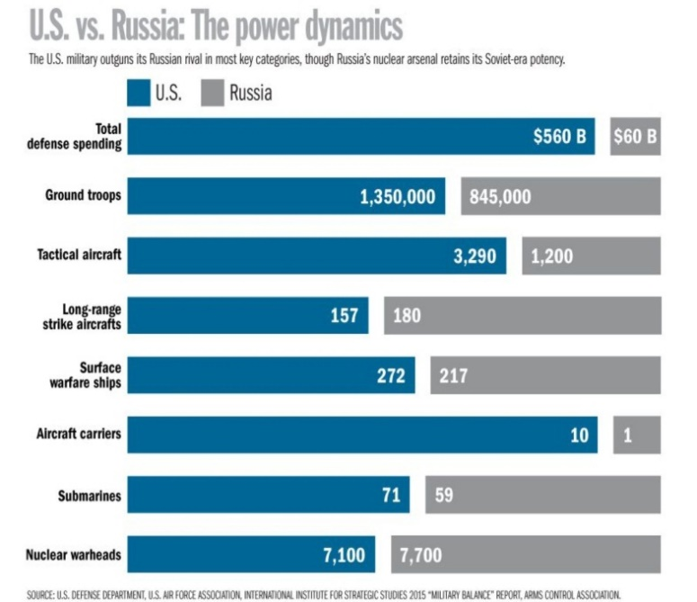
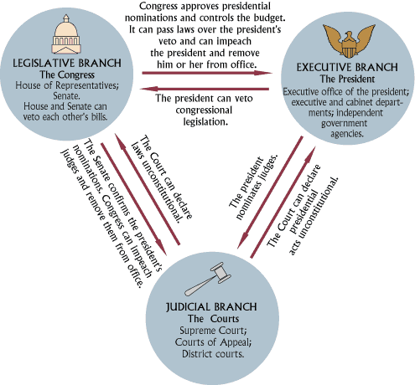
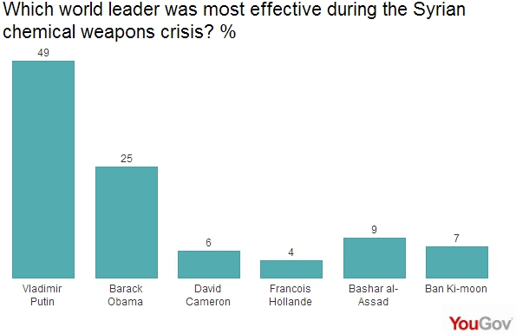
II. power
Relative: Who has more or less?
Capabilities vs. influence
Capability: the legal and material resources to act
“Having the means of power is not the same as being powerful” (Steven Lukes, 2005)
Influence: The ability of A to get B to do what B otherwise wouldn’t
Coercion: threats or prospective costs tied to non-compliance
Inducements: offering rewards to others

Slide 7
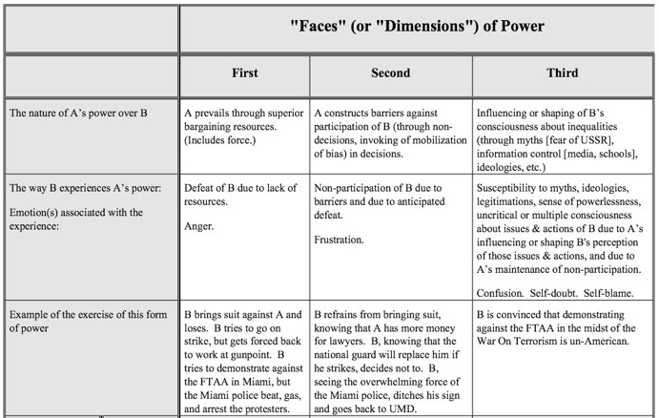
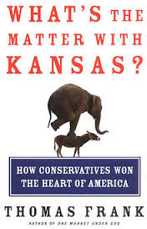
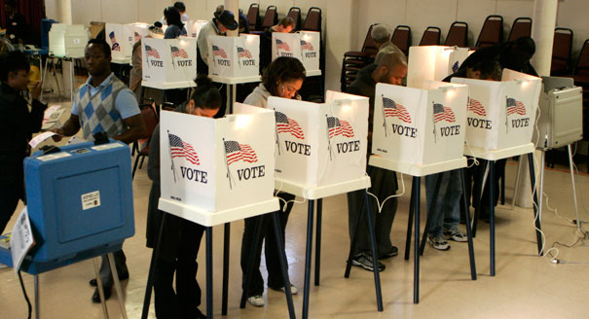
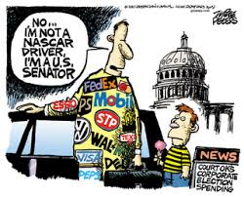
The three Faces of power
1st – Pluralism
The ability to achieve desired outcomes in the policy arena; Certain groups might exercise power in specific areas, no single group will dominate across the range of policy-making (p.56-7)
2nd – Agenda-Setting Elitism
The ability to create & reinforce institutional practices limiting the scope of the political process to only a few actors and only those issues desired by those powerful enough to keep damaging issues off the agenda
Left and New Right Variants (p.31-32)
3rd –False Consciousness
The “insidious exercise of power to prevent people …from having grievances by shaping their perceptions…and preferences (to) accept…the existing order (against their interests) as natural or unchangeable” (p.61)
“deeply condescending: social subject as an ideological dupe…the enlightened academic [able to] discern the genuine interests of those not similarly blessed”
Notes:
1st : power from the masses
2nd : power held by few who limit what the masses can control (special interests [possibly like NRA?])
3rd : what you believe is shaped by people in power so you don’t even know you have problems

Slide 8
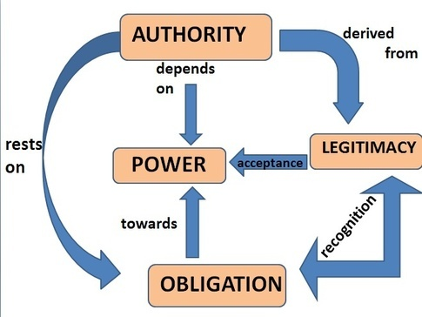
III. authority
Governing by Consent
Legitimacy: The acceptance of the exercise of power by the people on whom the power is exercised.
Authority: when power is exercised with legitimacy; the bestowed right to get things done.

Slide 9

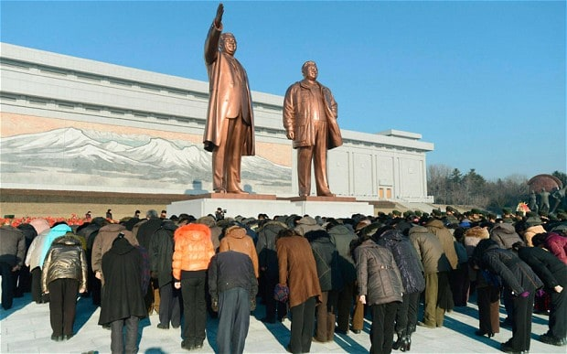
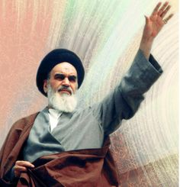
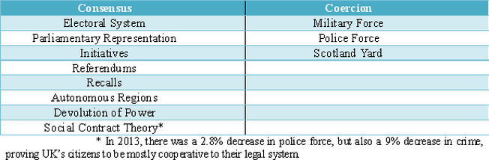
3 TYPES OF authority (Max weber p.52)
Traditional authority: derived from long-established customs and values.
Monarchies & Hereditary Succession
Charismatic authority: power legitimized by a leader's exceptional personal qualities and attributes, which inspire loyalty and obedience from followers
Dictatorship & Cult of personality; succession by revelation Source: Boundless. “Charismatic Authority.” Boundless Sociology. 2016. from https://www.boundless.com/sociology/textbooks/boundless-sociology-textbook/government-15/politics-power-and-authority-112/charismatic-authority-624-10334/
Legal-rational authority: derived from the status of an office within a constitutional framework.
Democracy; Succession based on agreed rules
http://iasexamportal.com/civilservices/courses/ias-mains/pub-ad/administrative-thought/webers-bureaucratic-model

